Slide 1


TAMU HPRC Resources for Research
help@hprc.tamu.edu

Slide 2
Introduction to TAMU HPRC

Slide 3
High Performance Research Computing
An interdisciplinary research environment that advances computational and data-enabled sciences, engineering, and scholarship
Our Mission
Enable research and discoveries that advance sciences and technologies.
Enable computational and data-enabled research activities of students, faculty, and staff at Texas A&M University.
Provide consulting, technical documentation, and training to support users of these resources.
Notes:
Established in 1989 and formerly known as Supercomputing Facility
Renamed as HPRC in 2014 and moved to Division of Research
HPRC was recognized as an Intel Parallel Computing Center in March 2016
NVidia GPU programming and Deep Learning workshops

Slide 4
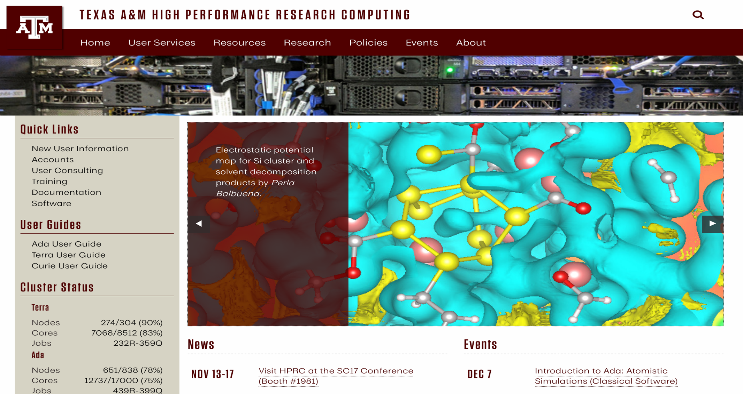
https://hprc.tamu.edu

Slide 5
High Performance Research Computing
Supports and maintains 4 HPC clusters over 770 Tflops total computing capacity and over 7 PB storage for active users
Access is open and free of charge to ALL faculty, research staff, students and external collaborators
Allocation by proposal is required
Staff consists of 15 professionals and 4 student workers.
Funding for staff from Division of Research at Texas A&M
Services provided:
  User Services: help desk, training, workshops, software support, user support for over 2300 users
  Systems: system admin functions (Linux), storage (GPFS and NFS), support servers, security, and other cyberinfrastructure support
Notes:
seven minutes each!

Slide 6
HPRC Computing Clusters -- https://hprc.tamu.edu/resources/
System | Service Units | Peak FLOPS
Terra (X86, GPU, KNL) | 74.6 M | 337 TF
Ada (X86, GPU, Phi) | 152 M | 397 TF
Curie (Power7) | 6.73 M | 26 TF
Lonestar (Cray XC40) | 14 M | 1,200 TF
HPRC Storage
System | Type | Capacity
Terra | GPFS | 4 PB
Ada | GPFS | 3 PB
Tiered | GPFS | 3.5 PB

Slide 7
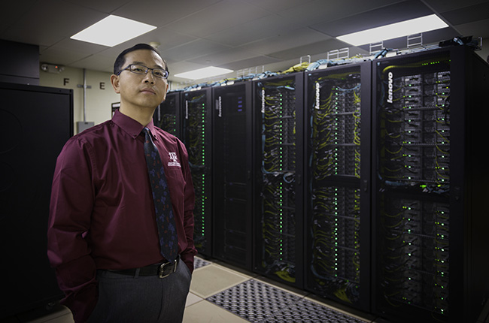
Terra: A New Lenovo x86 Cluster
A 8,512-core hybrid system with 48 NVIDIA K80 GPUs
304 28-core compute nodes equipped with the INTEL 14-core 2.4GHz Broadwell processor
48 nodes have 1 K80 GPU with 128GB memory each
Interconnect fabric is Intel OmniPath Architecture (OPA)
Notes:
seven minutes each!

Slide 8
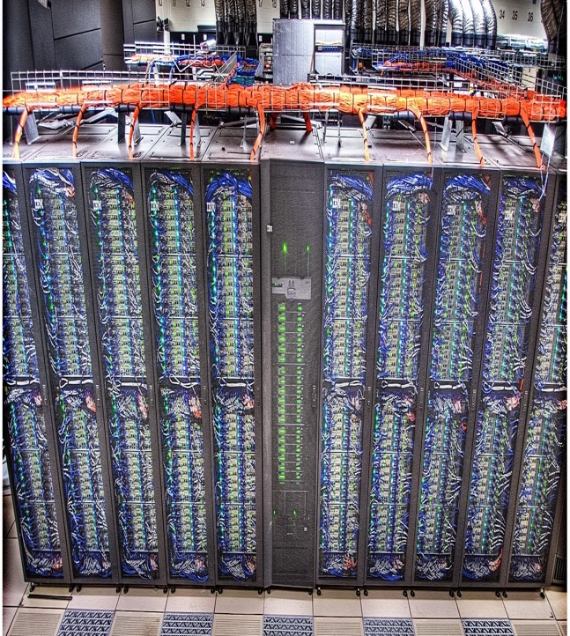
Ada: An IBM/Lenovo x86 Cluster
17,340-core hybrid system
845 20-core nodes equipped with the INTEL 10-core 2.5GHz IvyBridge processor.
15 nodes are 1TB and 2TB memory, 4-processor SMPs configured with the Intel 10-core 2.7GHz Westmere processors
30 nodes have 2 GPUs each
9 have 2 Phi coprocessors.
Notes:
seven minutes each!

Slide 9
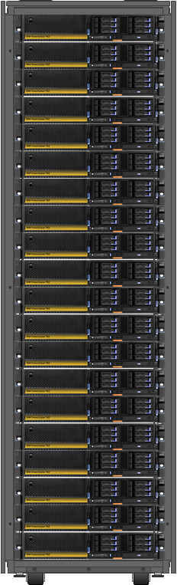
Curie: 50-node POWER7+ cluster
For Special HPC Codes & Applications
IBM 7R2 Node Characteristics
• 16-core ( 2 8-core Power7+ processors) 4.2GHz; 537GFLOPS; 32 nm fabrication
• 256 GB memory; 68GB/s per processor socket; L3 80MB/processor
• 10GbE port (link to Wehner Core 10G/40G switch)
• 4 x 600GB 10K rpm SAS (local disk)
• REDHAT ENTERPRISE LINUX FOR PWR ; GPFS Client; IBM Compilers, ESSL, LSF (batch)
• Target areas: applications & codes requiring fast memory and fast cpus
Notes:
seven minutes each!

Slide 10
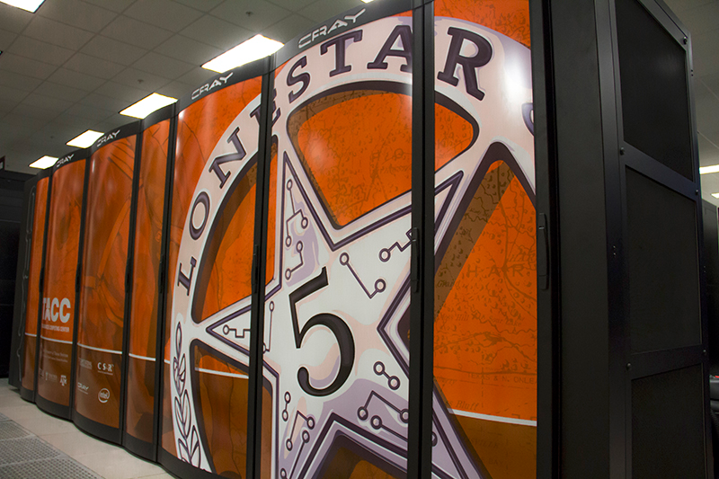
Lonestar 5: Cray x86 HPC Cluster
(1.25+ PFLOPS)
Lonestar 5 is a 30,048-core Cray x86 HPC cluster with
1252 Cray XC40 compute nodes, each with two 12-core Intel Xeon® processing cores for a total of 30,048 compute cores
2 large memory compute nodes, each with 1TB memory
8 large memory compute nodes, each with 512GB memory
16 Nodes with NVIDIA K-40 GPUs
5 Petabyte DataDirect Networks storage system
Cray-developed Aries interconnect
Jointly funded by the University of Texas System, Texas A&M University and Texas Tech University.
Notes:
seven minutes each!

Slide 11
HPRC Services
Notes:
seven minutes each!

Slide 12
HPRC Services
Computing cycles, storage and networking for researchers
Allocations and new user start-up assistance
Individual consulting
Advanced support (next slide)
Access to state and national advanced computing resources
Expertise to support your sponsored research projects
Training classes and workshops
Seminars and outreach events (like this one)
Notes:
seven minutes each!

Slide 13
Advanced Support Program
Porting applications to our clusters
Optimizing and analyzing serial code performance
Developing parallel code from serial versions and analyzing performance
Optimizing serial and parallel I/O code performance
Assisting in the optimal use of mathematical libraries
Assisting with code development and design
Assisting with the improvement of workflow automation in scientific processes
Notes:
seven minutes each!

Slide 14
Education, Outreach and Training
Notes:
seven minutes each!

Slide 15
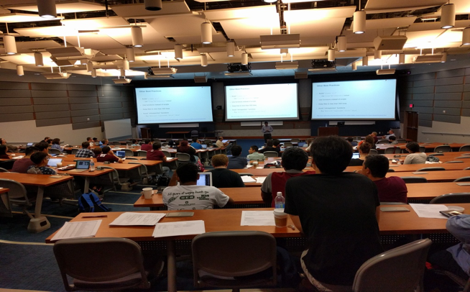
HPRC Training
HPRC training short courses
https://hprc.tamu.edu/training/
Computational Science workshops and seminars
https://hprc.tamu.edu/events/workshops/
Training and education at all levels, from K-12 to undergraduate students through graduate school and beyond, is an essential component of the HPRC’s year round activities
Summer programming camp for HS students
Notes:
seven minutes each!

Slide 16
Tiered Training Programs on Campus
Beginner
  Introduction to Linux/Unix Systems, Get started with Fortran, C/C++, Python, Shell Script, SVN/git, Latex, etc. Using scientific software with graphical user interface, etc.
  Currently offered by HPRC, Laboratory for Molecular Simulation, and others.
Intermediate
  MPI, OpenMP, OpenACC, CUDA, OpenCL, Numerical Libraries, Open Source Toolchain, Queue System, etc. Compiling and running applications on high performance systems such as Ada and Terra.
  Currently some materials are offered by HPRC and some big computer labs on campus.
Advanced
  Hybrid (MPI + X) Parallel Programming, Performance Analysis and Tuning, Computational Frameworks, etc. Writing, debugging, and tuning parallel code.
  Currently only introduced in a few graduate level courses on campus.
Register for HPRC Short Courses at https://hprc.tamu.edu/register/classlist.php
Notes:
seven minutes each!

Slide 17
HPRC Training Sessions
Introduction to the Linux | Data Management Practices
Introduction to Using the Ada and Terra Clusters | Using the Visualization Portal: Abaqus
Introduction to Perl | Using the Visualization Portal: ParaView
Introduction to CUDA | Intermediate CUDA Programming
Introduction to Databases | Introduction to R
Introduction to Python | Introduction to the MATLAB Parallel Toolbox
Introduction to Scientific Python | Molecular Modeling Workshop
Introduction to MATLAB Programming | Introduction to Code Parallelization using OpenMP
Python for MATLAB Users | Introduction to Code Parallelization using MPI
RNA Sequencing | Introduction to Next Generation Sequencing
NGS Metagenomics | NGS Assembly
NGS RADSeq/GBS | Introduction to HPRC Galaxy
Bring Your Own Code Workshops | Introduction to Fortran
Notes:
seven minutes each!

Slide 18
Software/Data Carpentry Workshops
Software Carpentry (SC) is a world renowned organization that was established in 1998 and teaches researchers the computing skills they need to get more done in less time and with less pain
https://software-carpentry.org/ https://datacarpentry.org
We are starting a campus-wide effort to plan workshops for the Fall and Spring semesters
Notes:
seven minutes each!

Slide 19
Documentation!
https://hprc.tamu.edu/wiki
Software -
https://hprc.tamu.edu/wiki/SW
Hardware –
https://hprc.tamu.edu/wiki/HPRC:Systems
Portal to HPC systems –
https://hprc.tamu.edu/wiki/SW:Portal
Galaxy –
https://hprc.tamu.edu/wiki/Ada:Galaxy
Quick start guides –
https://hprc.tamu.edu/wiki/Ada:QuickStart
https://hprc.tamu.edu/wiki/Terra:QuickStart
https://hprc.tamu.edu/wiki/Curie

Slide 20
Getting Started: HPRC Accounts and Allocations

Slide 21
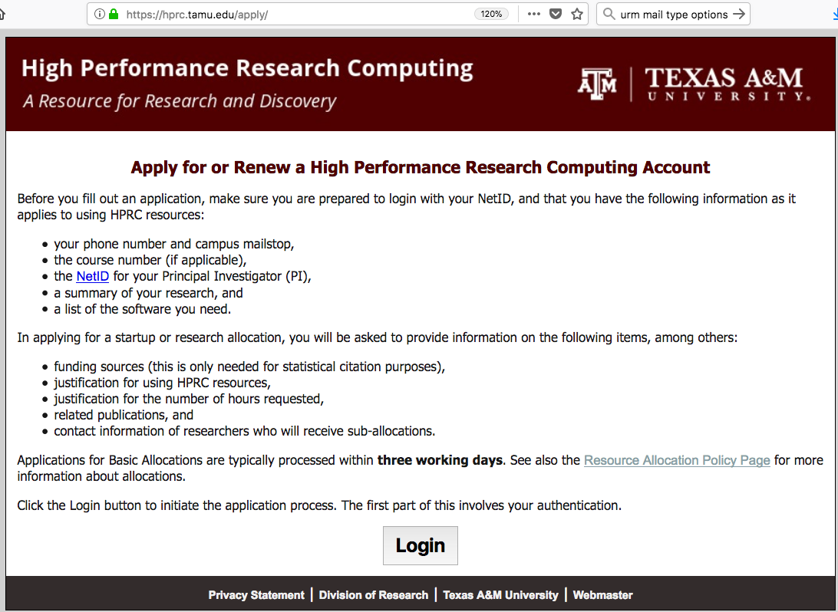
Apply for an account at https://hprc.tamu.edu/apply/

Slide 22
Allocation types information here…

Slide 23
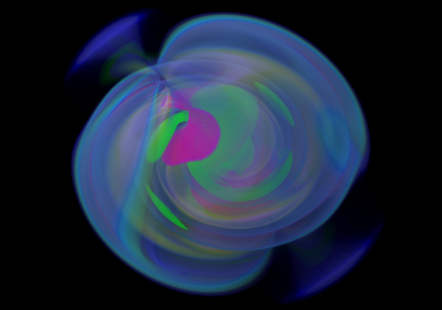
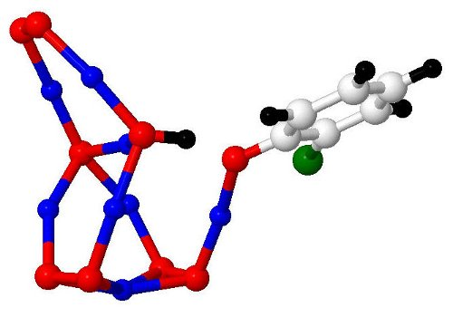
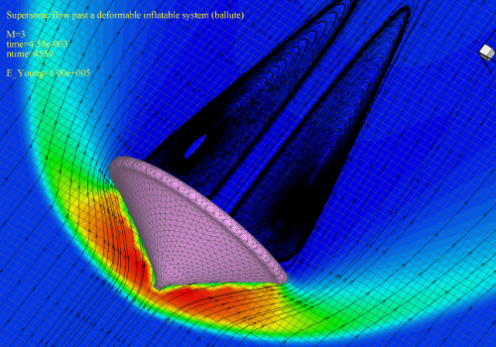
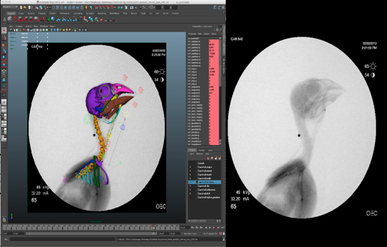

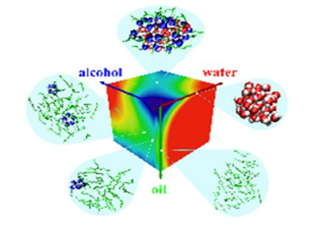
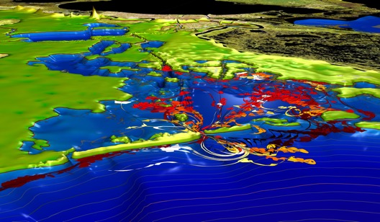

HPRC Enables Research

Slide 24
Introduction to Genomics and Bioinformatics Services

Slide 25
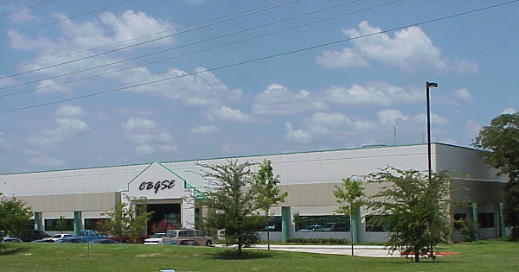


Center for Bioinformatics, Genomics and Systems Engineering
Bioinformatics, Computational Biology, and Systems Biology research in Life Science and Agriculture
Notes:
mention free parking

Slide 26
Genomics and Bioinformatics, Texas A&M AgriLife Research
Sequencing: DNA, RNA
Illumina, PacBio, Oxford Nanopore
Data Analysis
Work with faculty/researchers to design/conduct their genomic studies
Assist researchers in finding computational and financial resources
Analyze data from Next Generation Sequencing technologies
Investigate/develop/test/implement new bioinformatics tools
Manage large volume of biological datasets in a high-performance computational environment
Training
Providing mentoring for students, including serving in their dissertation committees and teaching them NGS concepts
Teaching bioinformatics classes, special focus on NGS data analysis

Slide 27
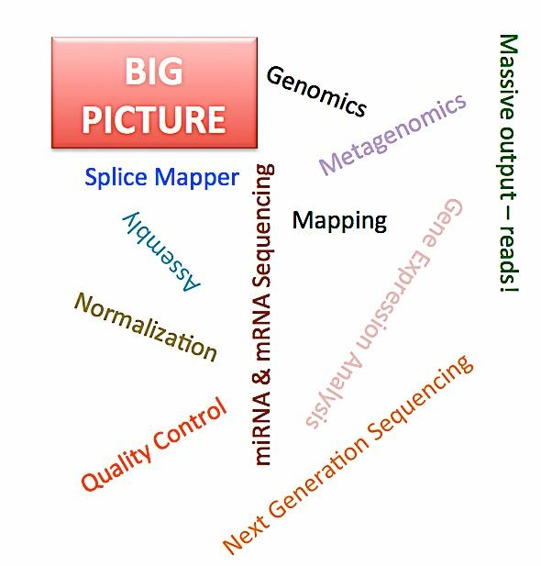
  Next Generation Sequencing Applications
  (not a comprehensive list)
  Alignment
  Assembly (no reference, with a reference)
    Genome
    Transcriptome
  RNA-Seq
  Metagenomics
  ChIP-Seq
  RADSeq

Slide 28
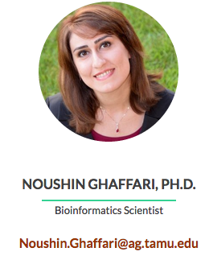
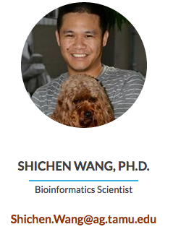
TxGen Bioinformatics Consultation Hours
Open Bioinformatics office hours twice a month in the Interdisciplinary Life Sciences Building on main campus
Providing in-person assistance for bioinformatics questions for faculty/students/researchers
Depending on the response we may expand both the number of hours and frequency
During these bioinformatics office hours, we will answer questions related to Next Generation Sequencing data processing and analysis
Bring your laptop if you have specific program questions!
Bioinformatics Office hours are held Biweekly from 1:00 – 3:00 PM in Room 1157B or by request

Slide 29
HPRC NGS Data Analysis Resources

Slide 30
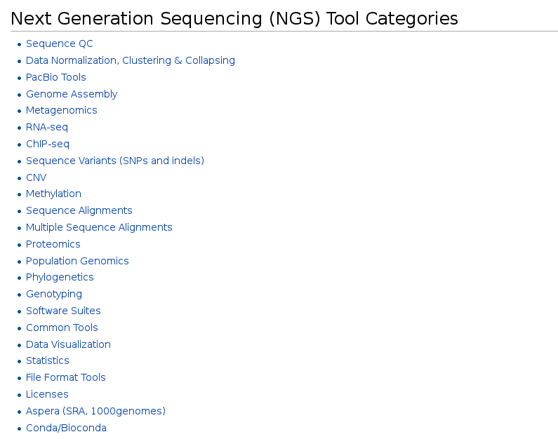
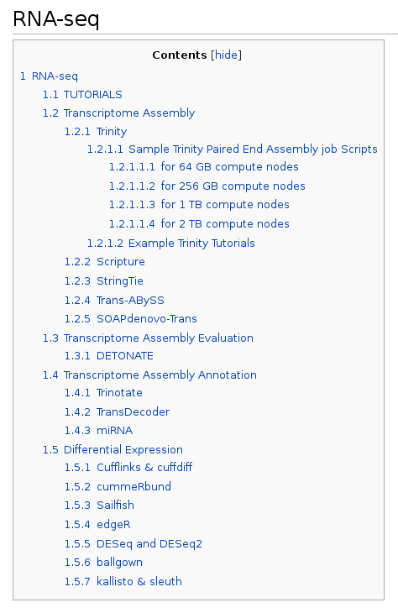
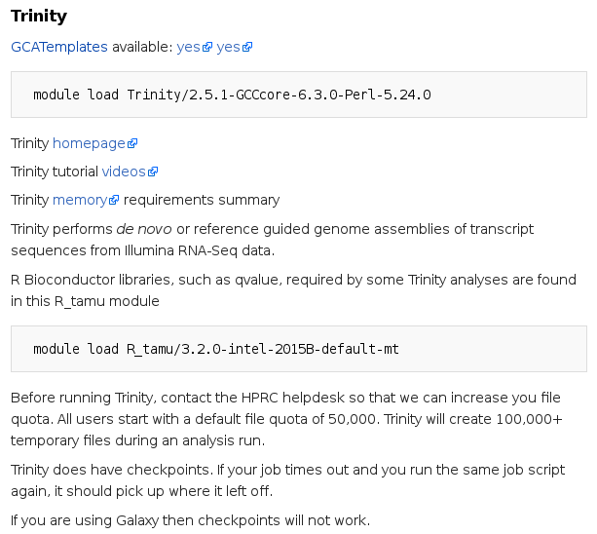
HPRC NGS Documentation
https://hprc.tamu.edu/wiki/Ada:Bioinformatics

Slide 31
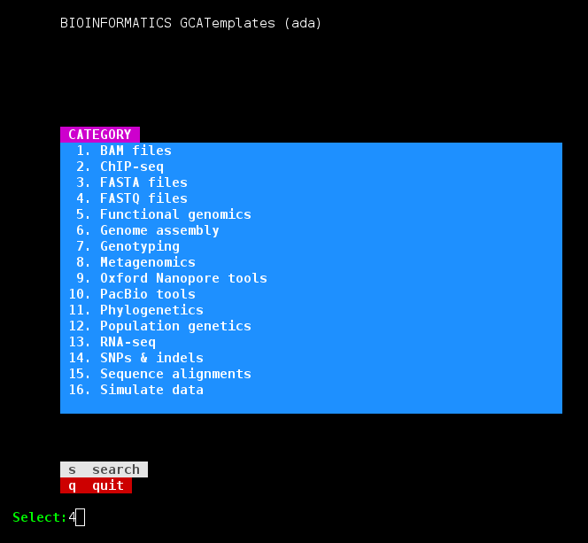
Genomic Computational Analysis (GCA) Templates
This HPRC resource provides numerous template job scripts to help you get started with your bioinformatics project
Template scripts use existing software modules on the HPRC cluster
Many have sample small datasets that you can run immediately for testing

Slide 32
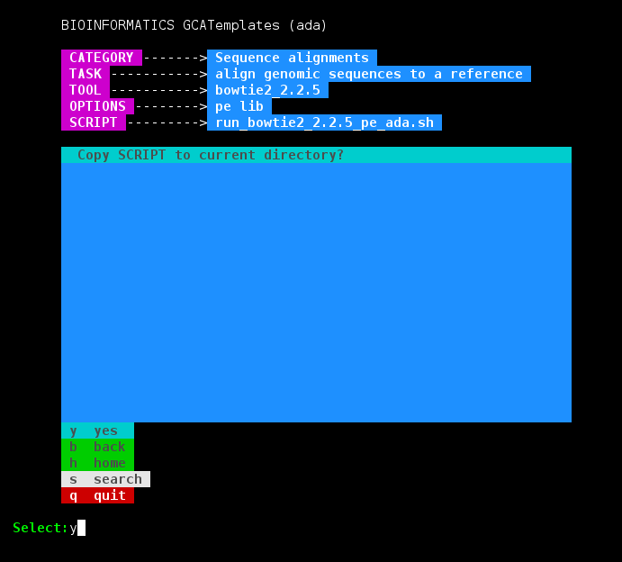
Genomic Computational Analysis Templates (GCATemplates)
Select CATEGORY, TASK, TOOL, OPTIONS to find a template SCRIPT
Copy the SCRIPT to your current directory
Edit the selected job script template with your input files and your job specific parameters

Slide 33
tamulauncher
blastn -query chunk0000.fa -db 'nt.bacteria' -task megablast -out chunk0000.fa.out -outfmt 6
blastn -query chunk0001.fa -db 'nt.bacteria' -task megablast -out chunk0001.fa.out -outfmt 6
blastn -query chunk0002.fa -db 'nt.bacteria' -task megablast -out chunk0002.fa.out -outfmt 6
blastn -query chunk0003.fa -db 'nt.bacteria' -task megablast -out chunk0003.fa.out -outfmt 6
blastn -query chunk0004.fa -db 'nt.bacteria' -task megablast -out chunk0004.fa.out -outfmt 6
blastn -query chunk0005.fa -db 'nt.bacteria' -task megablast -out chunk0005.fa.out -outfmt 6
blastn -query chunk0006.fa -db 'nt.bacteria' -task megablast -out chunk0006.fa.out -outfmt 6
blastn -query chunk0007.fa -db 'nt.bacteria' -task megablast -out chunk0007.fa.out -outfmt 6
blastn -query chunk0008.fa -db 'nt.bacteria' -task megablast -out chunk0008.fa.out -outfmt 6
blastn -query chunk0009.fa -db 'nt.bacteria' -task megablast -out chunk0009.fa.out -outfmt 6
blastn -query chunk0010.fa -db 'nt.bacteria' -task megablast -out chunk0010.fa.out -outfmt 6
blastn -query chunk0011.fa -db 'nt.bacteria' -task megablast -out chunk0011.fa.out -outfmt 6
blastn -query chunk0012.fa -db 'nt.bacteria' -task megablast -out chunk0012.fa.out -outfmt 6
blastn -query chunk0013.fa -db 'nt.bacteria' -task megablast -out chunk0013.fa.out -outfmt 6
blastn -query chunk0014.fa -db 'nt.bacteria' -task megablast -out chunk0014.fa.out -outfmt 6
blastn -query chunk0015.fa -db 'nt.bacteria' -task megablast -out chunk0015.fa.out -outfmt 6
blastn -query chunk0016.fa -db 'nt.bacteria' -task megablast -out chunk0016.fa.out -outfmt 6
blastn -query chunk0017.fa -db 'nt.bacteria' -task megablast -out chunk0017.fa.out -outfmt 6
blastn -query chunk0018.fa -db 'nt.bacteria' -task megablast -out chunk0018.fa.out -outfmt 6
blastn -query chunk0019.fa -db 'nt.bacteria' -task megablast -out chunk0019.fa.out -outfmt 6
blastn -query chunk0020.fa -db 'nt.bacteria' -task megablast -out chunk0020.fa.out -outfmt 6
blastn -query chunk0021.fa -db 'nt.bacteria' -task megablast -out chunk0021.fa.out -outfmt 6
blastn -query chunk0022.fa -db 'nt.bacteria' -task megablast -out chunk0022.fa.out -outfmt 6
blastn -query chunk0023.fa -db 'nt.bacteria' -task megablast -out chunk0023.fa.out -outfmt 6
compute node 1
compute node 2
tamulauncher
compute node 3
compute node 4
compute node 5
A convenient way to run a large number of single core jobs
Only need to submit one job instead of many small jobs
Useful for submitting thousands of BLAST jobs

Slide 34
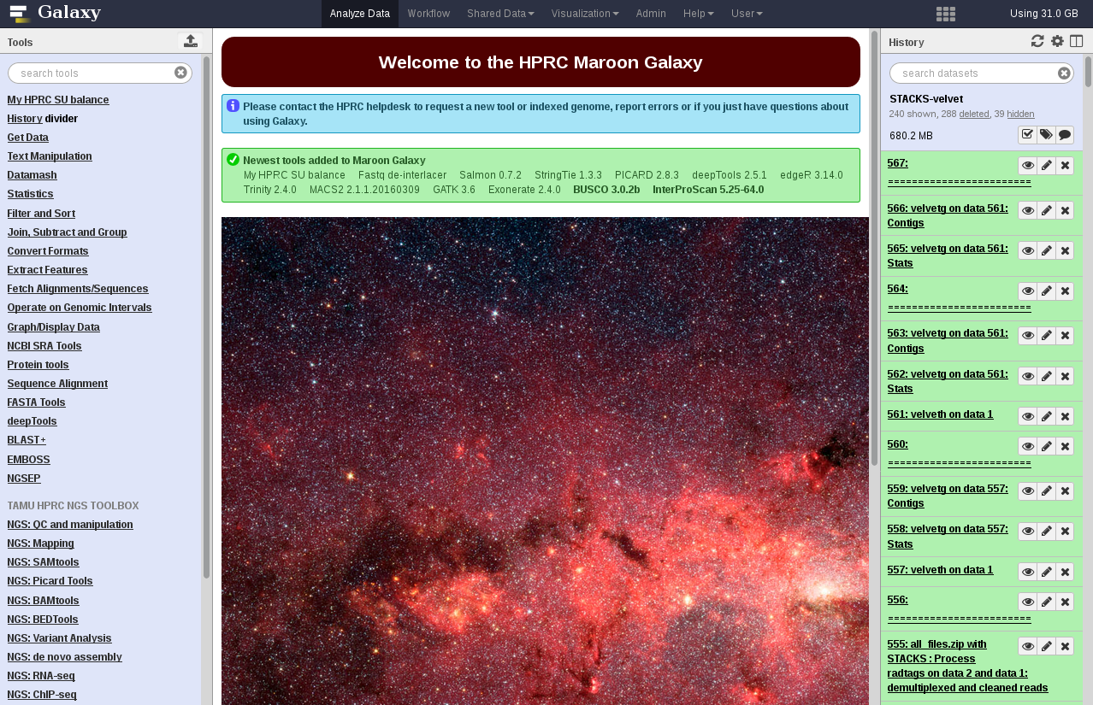
https://hprcgalaxy.tamu.edu/maroon

Slide 35
HPRC Next Generation Sequencing (NGS) Related Short Courses
Introduction to NGS Data Analysis
RNA Sequencing
NGS Assembly
NGS Metagenomics
Introduction to HPRC Galaxy
NGS RADSeq/GBS

Slide 36
Atomistic Simulations
High Performance Research Computing (HPRC)
Laboratory for Molecular Simulation (LMS)

Slide 37
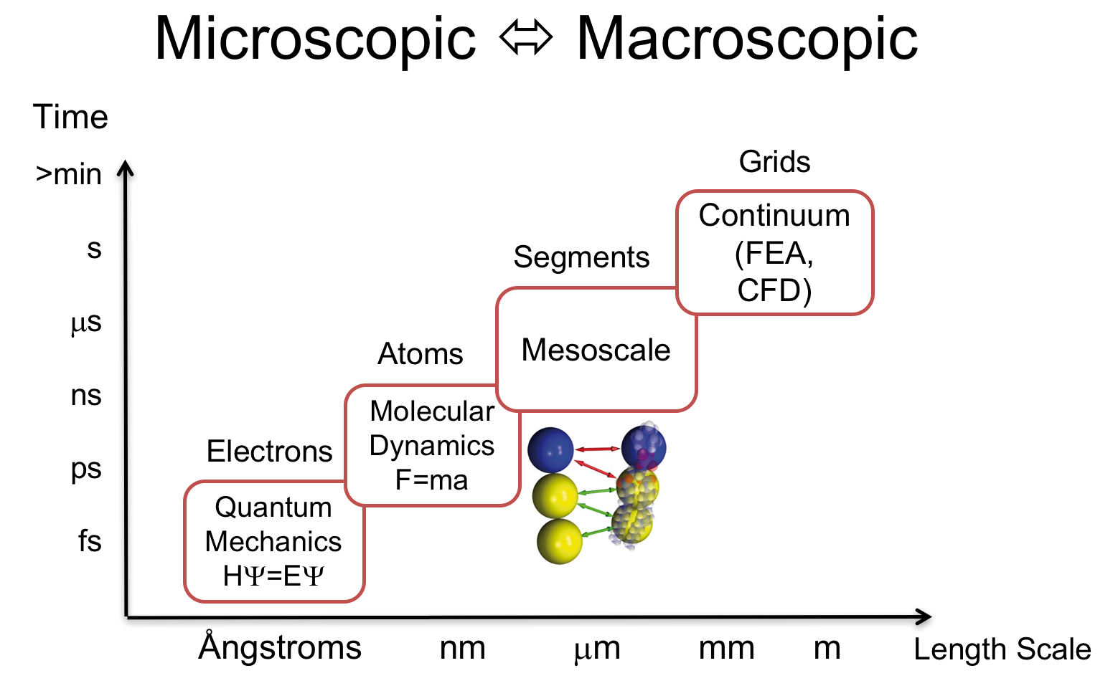
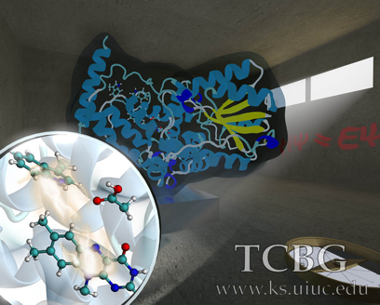
Atomistic Simulations
Protein structure prediction (Homology Modeling)
Site Mutations effects
Molecular Dynamics
Protein Dynamics
Protein-Protein Docking
Ligand Docking
Small molecule properties
Reaction Mechanisms
UV-Vis spectra, NMR, IR
and much more

Slide 38
Atomistic Simulation Software on HPRC systems
Future Installs:
CHARMM Lite (Free)
Desmond (Free)
Materials Studio (Restricted)
MOE (Restricted)
Schrödinger Software (Restricted)
MOLPRO (Restricted)
Open Molcas (Free)
ORCA (Free)
Octopus (Free)
Current Installs:
Classical
AMBER (Restricted)
AutoDock Vina (Free)
CHARMM (Restricted)
GROMACS (Free)
LAMMPS (Free)
NAMD (Free)
Quantum
ABINIT (Free)
Gaussian (Restricted)
NWChem (Free)
Quantum Espresso (Free)
VASP (Restricted)
Wien2k (Restricted)

Slide 39
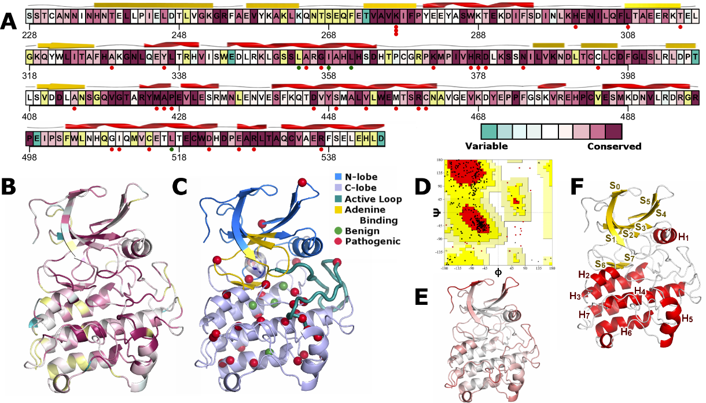
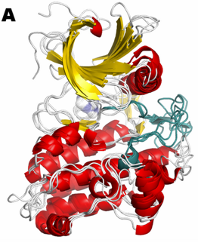
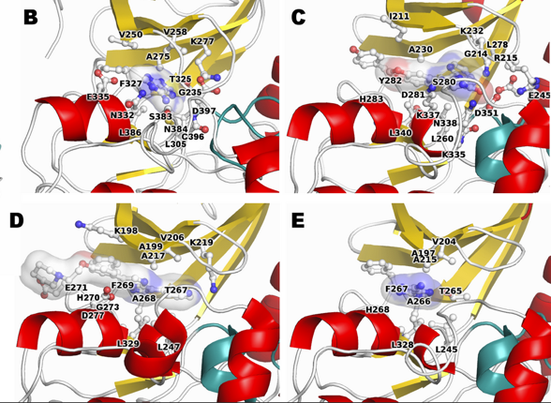
Atomistic Simulations and Next Generation Sequencing
http://journals.plos.org/plosone/article?id=10.1371/journal.pone.0170822

Slide 40
Introduction to OpenOnDemand

Slide 41
What is OpenOnDemand
An open source software developed at the Ohio Supercomputing Center
Enables HPC centers to deploy advanced web and graphical interface for their users
Provides an integrated single access point for all HPC resources and services
Extensible design for easy deployment of new services (applications)

Slide 42
How to Access TAMU OnDemand
You need a valid account on the Ada cluster
Open https://portal.hprc.tamu.edu in a browser
Login with your NetID and password
VPN is needed if accessing the URL from off campus
Logout and close the browser when you are done, especially if you use a public computer.

Slide 43
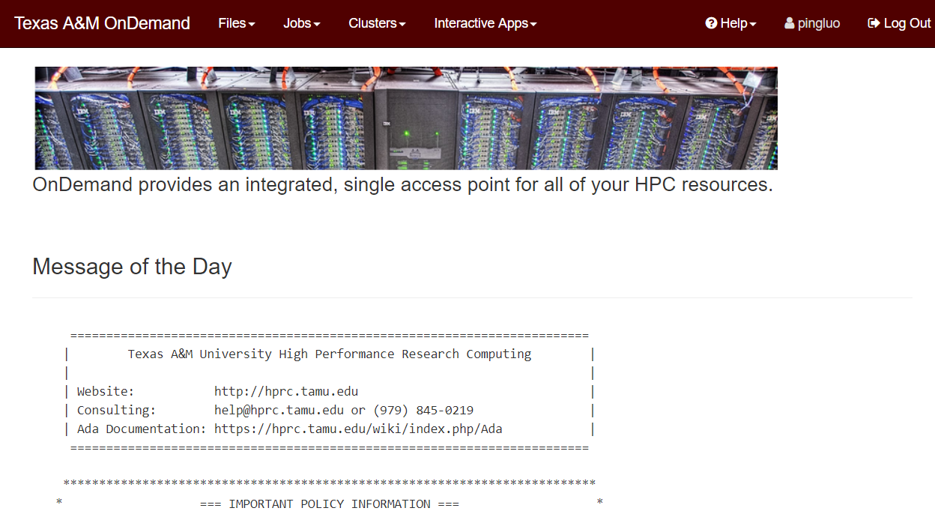
TAMU OnDemand Dashboard

Slide 44
Currently Supported Applications
Files
Jobs
Clusters
Jupyter
More applications coming soon
  RStudio
  MATLAB
  Abaqus
  ANSYS
  COSMOL
  many more ...

Slide 45
Contact the HPRC Helpdesk
Website: hprc.tamu.edu
Email: help@hprc.tamu.edu
Telephone: (979) 845-0219
Visit us in person: Henderson Hall, Room 114A
Help us, help you -- we need more info
  Which Cluster
  UserID/NetID
  Job id(s) if any
  Location of your jobfile, input/output files
  Application used if any
  Module(s) loaded if any
  Error messages
  Steps you have taken, so we can reproduce the problem

Slide 47
Agenda
11:30 - 11:45
Welcome
Lunch
11:45 - 12:45
Introduction to TAMU HPRC (Rick McMullen)
How to get allocation on HPRC systems
Introduction to Genomics and Bioinformatics Services (Noushin Ghaffari)
Genomics data analysis resources (Michael Dickens)
Atomistic Simulations (Lisa M. Perez, LMS)
Introduction to OpenOnDemand (Ping Luo)
Bring-Your-Own-Code (BYOC) (Jian Tao)
12:45 - 1:00
Questions
Accepting applications for allocations
Resolving login issues
Notes:
seven minutes each!

